Slide 1
Concurrency:
Deadlock and Starvation
Chapter 6

Slide 2
Deadlock
Permanent blocking of a set of processes that either compete for system resources or communicate with each other
No efficient solution
Involve conflicting needs for resources by two or more processes

Slide 3
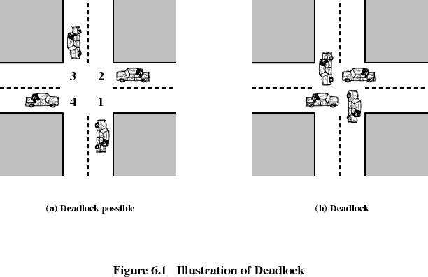

Slide 4
Reusable Resources
Used by one process at a time and not depleted by that use
Processes obtain resources that they later release for reuse by other processes
Processors, I/O channels, main and secondary memory, files, databases, and semaphores
Deadlock occurs if each process holds one resource and requests the other

Slide 5
Example of Deadlock
Space is available for allocation of 200K bytes, and the following sequence of events occur
Deadlock occurs if both processes progress to their second request
P1
….
Request 80 KB
….
Request 60 KB
…
Release 80 KB
Release 60 KB
P2
….
Request 70 KB
….
Request 85 KB
…
Release 70 KB
Release 85 KB

Slide 6
Consumable Resources
Created (produced) and destroyed (consumed) by a process
Interrupts, signals, messages, and information in I/O buffers
Deadlock may occur if a Receive message is blocking
May take a rare combination of events to cause deadlock

Slide 7
Example of Deadlock
Deadlock occurs if receive is blocking
P1
….
Receive(P2);
….
Send(P2, Message1)
P2
….
Receive(P1);
….
Send(P1, Message2)

Slide 8
Addressing Deadlock
Prevention: Design the system so that deadlock is impossible
Avoidance: Construct a model of system states, then choose a strategy that, when resources are assigned to processes, will not allow the system to go to a deadlock state
Detection & Recovery: Check for deadlock (periodically or sporadically), then recover
Manual intervention: Have the operator reboot the machine if it seems too slow

Slide 9
Deadlock Prevention
Necessary conditions for deadlock
  Mutual exclusion
  Hold and wait
  No preemption
  Circular waiting
Ensure that at least one of the necessary conditions is false at all times

Slide 10
“Mutual exclusion” condition
  only one process may use a resource
  at a time
To prevent deadlock
➔ do not require “mutual exclusion”
  If this is a resource constraint, then mutual exclusion must hold at all times.
  (i.e. you can’t do anything about it!)

Slide 11
“Hold and Wait” condition
To prevent deadlock ➔ avoid hold and wait!
Need to be sure a process does not hold one resource while requesting another
Approach 1: Force a process to request all resources it needs at one time
Approach 2: If a process needs to acquire a new resource, it must first release all resources it holds, then reacquire all it needs

Slide 12
“No preemption” condition
To prevent deadlock ➔ allow preemption!
  If a process holding certain resources is denied a further request, that process must release its original resources (➔ inefficiency in resource use)
  If a process requests a resource that is held by another process, the OS may preempt the second process and require it to release its resources
  (➔ waste of CPU and other resources)
  Can only be used in certain cases

Slide 13
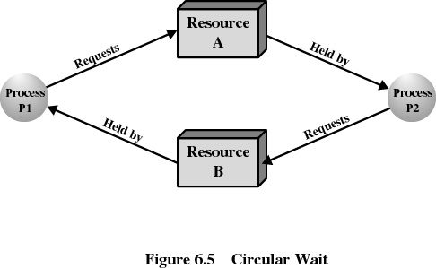
“Circular wait” condition
To prevent deadlock
➔ don’t go into a circular wait situation!

Slide 14
Circular Wait
  Prevented by defining a
  linear ordering of resources!
Have a situation in which there are K processes holding units of K resources
R_{k}
P
R
R_{x}
P(process) holds R(resource)
P_{i}
..
..
R_{y}
P
R
R_{z}
P_{i+1}
P requests R

Slide 15
Circular Wait (cont.)
For deadlock to occur, there must be a cycle in the graph of processes and resources
Choose a resource request strategy by which no cycle will be introduced
Total order on all resources,
then can only ask for R_{j} if R_{j} > R_{i} for all R_{i} the process is currently holding

Slide 16
Deadlock Avoidance
Define a model of system states, then choose a strategy that will guarantee that the system will not go to a deadlock state
Requires extra information, e.g., the maximum claim for each process
Resource manager tries to see the worst case that could happen. It does not grant an incremental resource request to a process if this allocation might lead to deadlock

Slide 17
Resource Allocation Denial
Referred to as the Banker’s algorithm
State of the system is the current allocation of resources to processes
Safe state is where there is at least one sequence that does not result in deadlock
Unsafe state is a state that is not safe

Slide 18
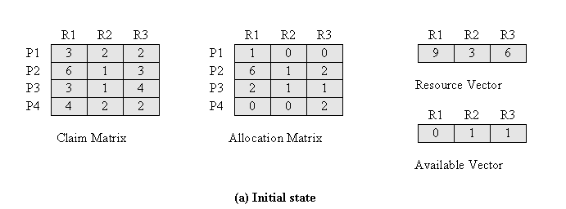
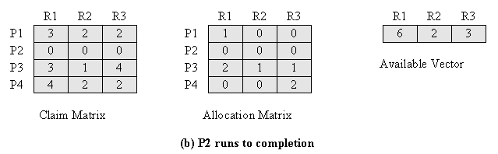
Is This State Safe ?

Slide 19
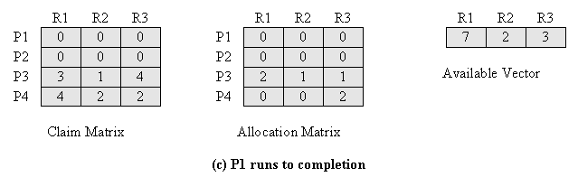
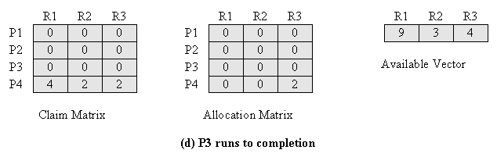
Is This State Safe ?
Yes, the given state is SAFE ! Because there is at least one scenario
in which all processes can finish: P2, P1, P3, and P4

Slide 20
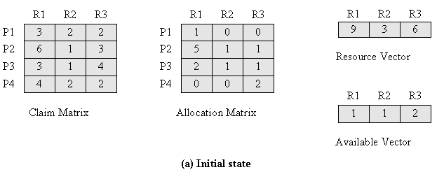
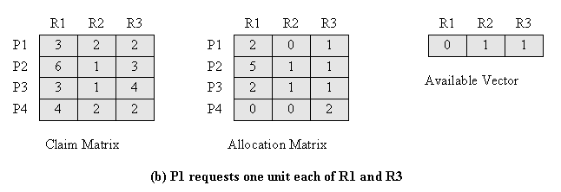
Determination of An
Unsafe State
Q: Should we give P1 the resources it needs?
A: No! Because, there is a possibility that a deadlock may occur!

Slide 21
Deadlock Avoidance
Max. resource requirement must be stated in advance
Processes under consideration must be independent; no synchronization requirements
There must be a fixed number of resources to allocate
No process may exit while holding resources

Slide 22
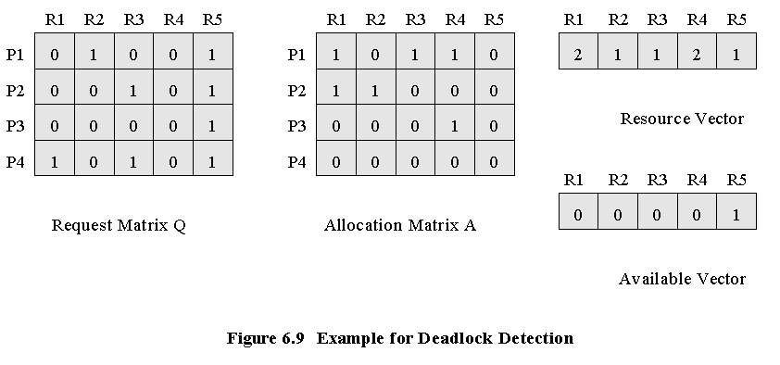
Deadlock Detection

Slide 23
Deadlock Detection
1. Mark P4 as “not deadlocked”,
because P4 has no allocated resources
2. Available vector = (0 0 0 0 1)
3. P3’s request vector ≤ (0 0 0 0 1)
so mark P3 as “not deadlocked”, and release its resources
Now,
Available vector = (0 0 0 1 1)
4. Unfortunately, no other process has a row ≤ Available vector
5. Therefore ====> P1 and P2 are deadlocked.

Slide 24
Strategies once
Deadlock is Detected
Abort all deadlocked processes
Back up each deadlocked process to some previously defined checkpoint, and restart.
  original deadlock may occur
Successively abort deadlocked processes until deadlock no longer exists
Successively preempt resources until deadlock no longer exists

Slide 25
Selection Criteria for terminating a deadlocked process
Least amount of processor time consumed so far
Least number of lines of output produced so far
Most estimated time remaining
Least total resources allocated so far
Lowest priority

Slide 26
Dining Philosophers
while(TRUE) {
think();
get2chopsticks();
eat();
}

Slide 27
Mechanisms to facilitate Concurrency in UNIX
Shared memory
Threads
Semaphores
Signals
Pipes
Messages

Slide 28
Thread Synchronization Primitives
SOLARIS POSIX
Mutual exclusion (mutex) locks
  mutex_lock() pthread_mutex_lock()
  mutex_trylock() pthread_mutex_trylock()
  mutex_unlock() pthread_mutex_unlock()
Condition variables
cond_wait() pthread_cond_wait()
  cond_signal() pthread_cond_signal()

